Slide 1
Sean Koppenhafer, Jaime Rodriguez,
Chad Thueson, Noah Erickson, Rishal Dass
Weekly meeting, 06/3/2015
Digital Dash
Portland State University
Department of Electrical and Computer Engineering (ECE)
Notes:
1
1

Slide 2
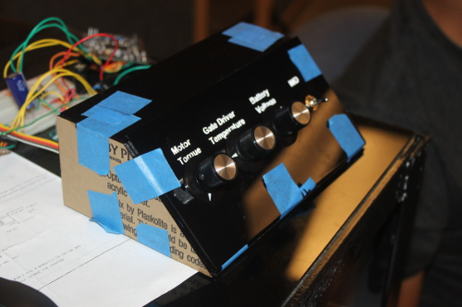
Demo Unit
Final demo unit enclosure finished
New Arduino Due programming correctly (problem with buffer)
Screen update lag fixed, ATMEGA16u2 interfering with serial, tri-state buffer fixed this
Demo code on vehicles GEVCU is working
Troubleshot polling code, not going to work due to hardware limitation
Wiring harness complete so we do not have to take apart dash unit, plugs into demo or car

Slide 3
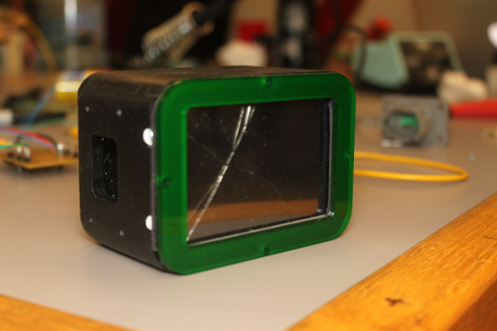
VMS Digital Dashboard
Final Code
Freeze up stopped, fixed by tri-state buffer
Polling based will not work
Enclosure completed
Cut out of 1/8” acrylic
Removable green faceplate for component access
Need to create mounting bracket and cut out holes on the vehicles dash (to be completed Tuesday night)
Custom Board
Populated new board
Onboard programmer functioning!
EagleCAD schematic updated, revision 2 done

Slide 4
Documentation
Poster received and mounted to backing
Sponsor presentation is prepared
Michal’s wiki changes are completed and repository organized
User manual is complete
No progress on report

Slide 5
Goals For The Next Two Days
Documentation
Present to VMS team Thursday, June 4th at 2PM in the ECE conference room
Capstone poster session on Friday, June 5th
Finish report
System
Prevent screen from locking up
Install on car
Mighty mugs when finished or all hope is lost
Notes:
5

